Slide 1

contact@softyeducation.com

Slide 2
Day 1

Slide 3
Content :
Asking the user for input
Comments
Type Conversion
Exercises

Slide 4
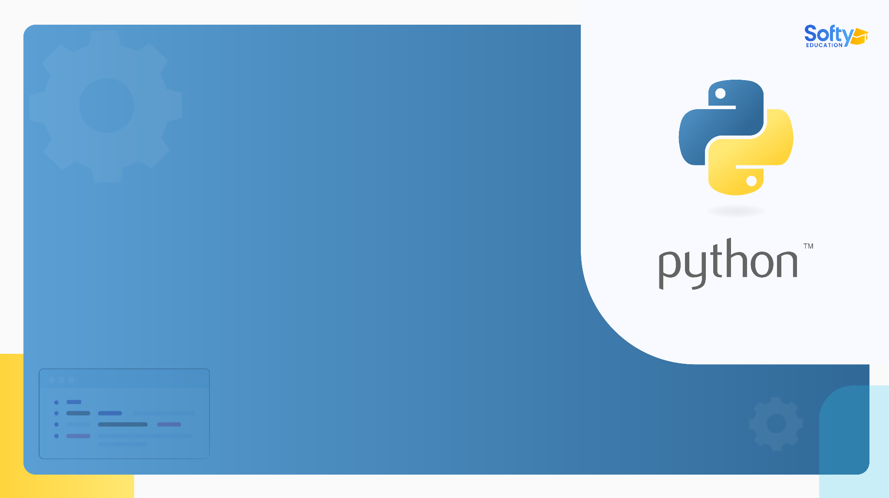
Asking for input
01

Slide 5
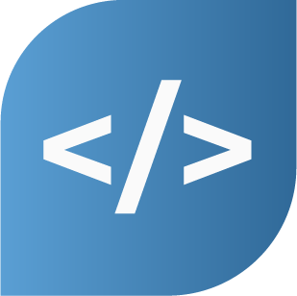
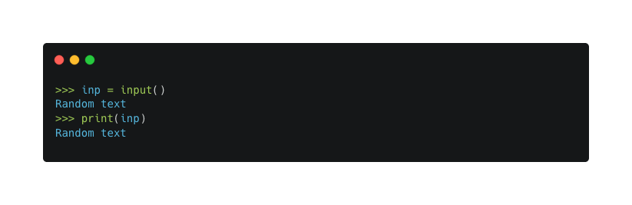
01- Asking for input
In Python, you can get input from the user using the input() function. It stops the program and waits for the user to type something. When the user presses Enter, the program continues, and input() returns what the user typed as a string.
‹#›

Slide 6
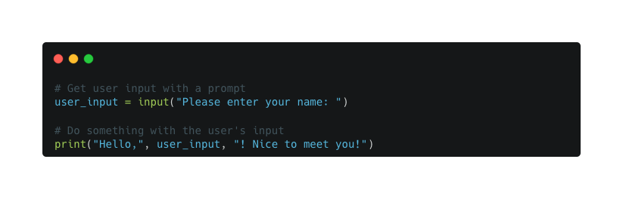
01- Asking for input
Before asking the user for input, it's helpful to show them a message telling them what to input. You can do this using the input() function and passing a string as a prompt. The prompt will be displayed to the user, and the program will pause, waiting for the user to enter their input.
‹#›

Slide 7
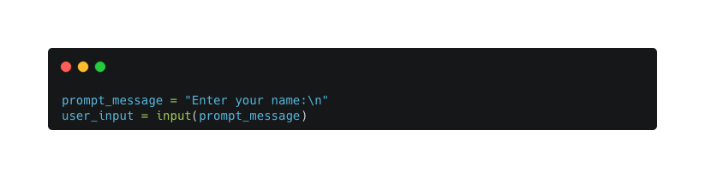

01- Asking for input
The sequence \n at the end of the prompt is like a special code for a newline, which makes a line break. It's the reason why the user's input appears below the prompt.
‹#›

Slide 8
02
Comments

Slide 9
02- Comments
As programs become larger and more complex, they become harder to understand. Formal programming languages can be quite condensed, making it challenging to grasp the purpose or logic behind a piece of code. To address this issue, it's helpful to add comments to your code.
‹#›

Slide 10
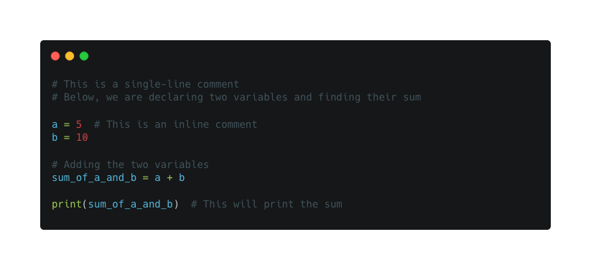
02- Comments
‹#›

Slide 11
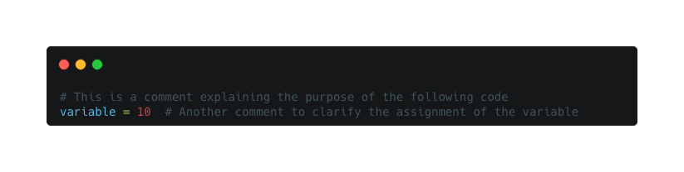
02- Comments
Comments are explanations written in natural language that describe what the program is doing. In Python, comments are marked by the # symbol:
‹#›

Slide 12
02- Comments
By using comments, you can make your code more readable and easier to comprehend, both for yourself and others who might read your code later.
Good variable names can reduce the need for comments, but long names can make
complex expressions hard to read, so there is a trade-off
‹#›

Slide 13
03
Type Conversion

Slide 14
03- Type Conversion
Type conversion, also known as type casting, is the process of converting one data type into another. In Python, you can perform type conversion on user input to ensure that the input is of the desired data type. This is especially useful when you expect specific types of data but receive them as strings from the user.
‹#›

Slide 15
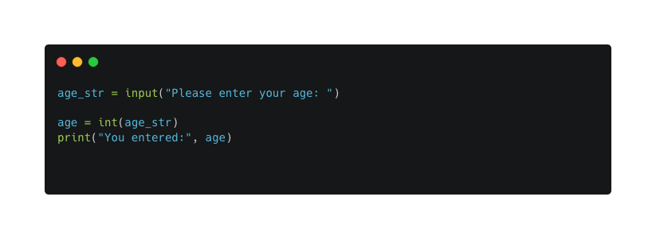
03- Type Conversion
Here's an example that takes user input for age and converts it to an integer:
‹#›

Slide 16
03- Type Conversion
In this example, the input() function is used to prompt the user for their age, and the input is stored as a string in the age_str variable.
Next, we use the int() function to convert age_str into an integer. If the input can be successfully converted to an integer.
‹#›

Slide 17
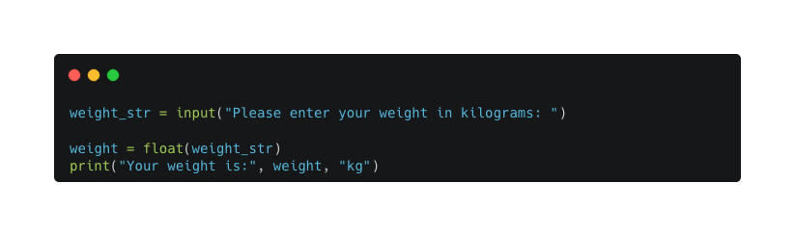
03- Type Conversion
Let's see another example where we convert the user input to a float:
‹#›

Slide 18
03- Type Conversion
In this example, we use the float() function to convert the user's weight input to a floating-point number.
‹#›

Slide 19
04
Exercises

Slide 20
04- Exercises
Asking the User for Input
Exercise 1.1: Write a program that asks the user for their name and age, and then prints a greeting that includes both.
Exercise 1.2: Write a program that asks the user for two numbers, and then prints their sum.
Exercise 1.3: Write a program that asks the user for their favorite color, then prints a sentence like "Your favorite color is blue!"
‹#›

Slide 21
04- Exercises
Comments
Exercise 2.1: Take any code snippet you have (it could be from one of the previous exercises), and add appropriate single-line and inline comments explaining the code.
‹#›

Slide 22
04- Exercises
Type Conversion
Exercise 3.1: Write a program that asks the user for a floating-point number and converts it into an integer, then prints both the original and converted values.
Exercise 3.2: Write a program that asks the user for two strings representing numbers, converts them into integers, and then prints their product.
‹#›

Slide 23
04- Exercises
Type Conversion
Exercise 3.3: Write a program that asks the user for their age (as a number) and their name (as a string), then prints a greeting. Use type conversion to make sure that the input is in the correct format.
‹#›

Slide 24
Thank you

